Slide 1

Introduction to ASP.NET Core (MVC)
ASP.NET Core, Controllers & Actions, Routing, Razor, Identity
SoftUni Team
Technical Trainers
Software University
https://softuni.bg

Slide 2
Table of Contents
ASP.NET MVC Overview
Creating an ASP.NET MVC App
Controllers
Views
ASP.NET Controllers
Razor View Engine
2

Slide 3

ASP.NET MVC Overview
ASP.NET MVC, Razor

Slide 4
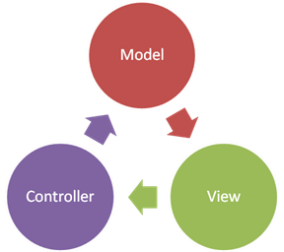
ASP.NET MVC Overview
Open Source Web Application MVC framework
Developed by Microsoft
Code and markup are separated
Based on .NET Framework / .NET Core
Develop Web apps using C# and use all of its features and .NET APIs
Often combined with Entity Framework for ORM
Typically uses Razor as a view engine (templating engine)

Slide 5
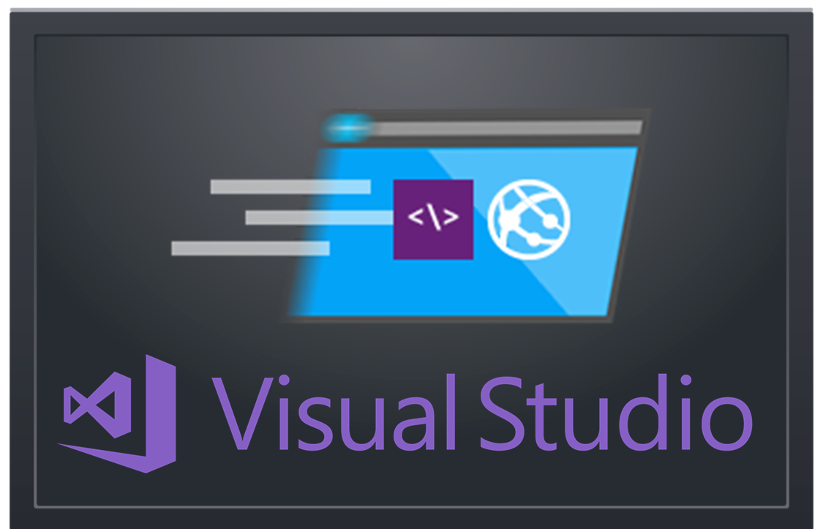
Creating an ASP.NET MVC App
Project Setup in Visual Studio. What’s Inside?

Slide 6
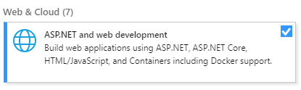
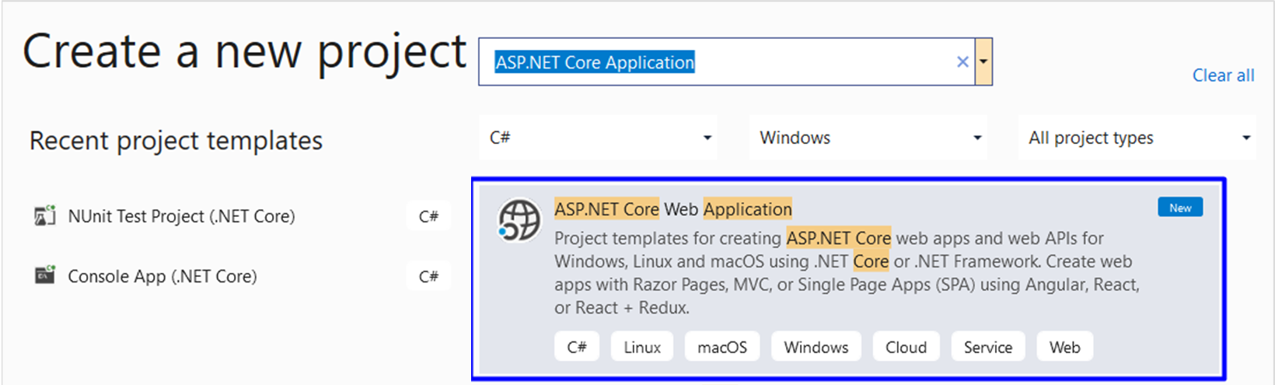
Create ASP.NET MVC App: Project Type
Install this in VS 2019!

Slide 7
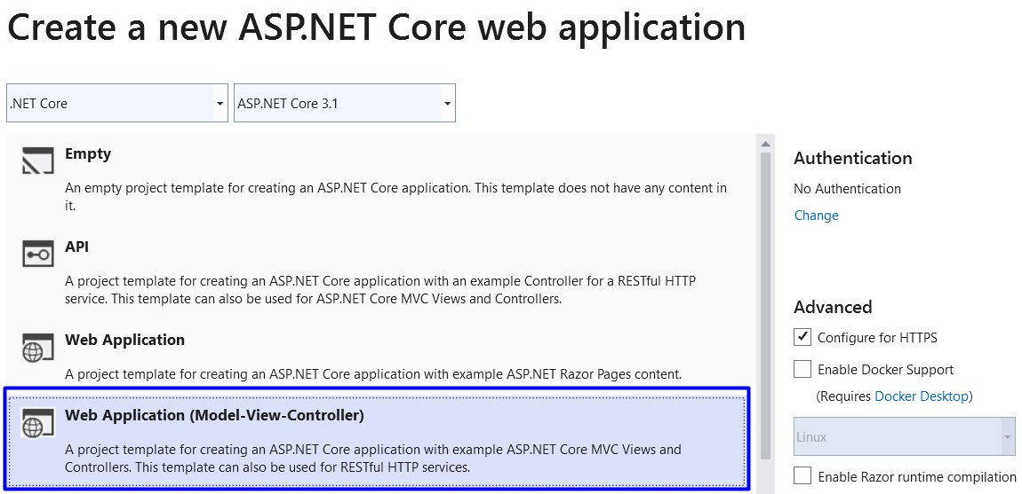
Create ASP.NET MVC App: Choose Template

Slide 8
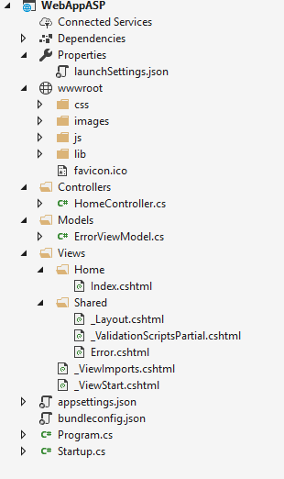
MVC App: What's Inside?
Static files: CSS styles images, fonts, …
NuGet packages
Controller classes holding actions
Models: EF classes + view models
Views: HTML templates for the pages
Shared views: layout for all pages + partial views
App start files

Slide 9
Controllers
MVC controllers hold logic to process user actions
The URL /Home/About invokes HomeController → About()
\Controllers\HomeController.cs
public class HomeController : Controller
{
public ActionResult About()
{
ViewBag.Message = "Your application description page.";
return View();
}
}
Renders Views\Home\About.cshtml

Slide 10
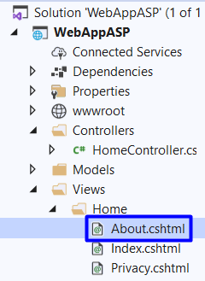

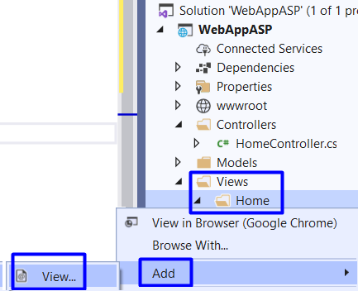
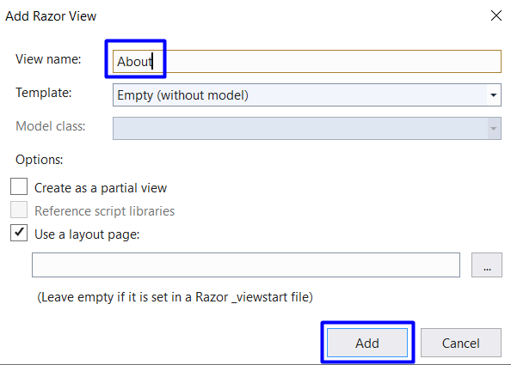
Views
Views render the HTML code for the invoked action
Create About.cshtml view

Slide 11
Views
ASP.NET MVC uses Razor view engine
Views combine HTML with C# code
\Views\Home\About.cshtml
@{
ViewBag.Title = "About";
}
<h2>@ViewBag.Title</h2>
<h3>@ViewBag.Message</h3>
<p>Use this area to provide additional information.</p>
@ { … } inserts C# code block
@Something prints a C# variable
Everything else is HTML code

Slide 12
Example: Print the Numbers 1…50
Create an action /Home/Numbers + view Numbers.cshtml
HomeController.cs
\Views\Home\Numbers.cshtml
public class HomeController : Controller
{
public ActionResult Numbers()
{
return View();
}
}
@{ ViewBag.Title = "Nums 1 … 50"; }
<h2>@ViewBag.Title</h2>
<ul>
@for (int i = 1; i <= 50; i++)
{
<li>@i</li>
}
</ul>

Slide 13
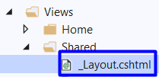
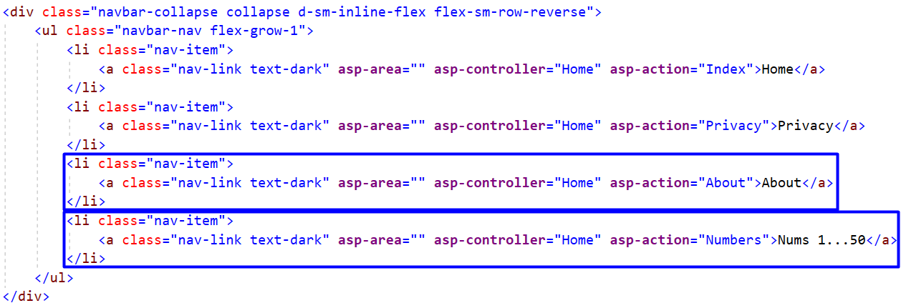
Changing the Page Layout

Slide 14
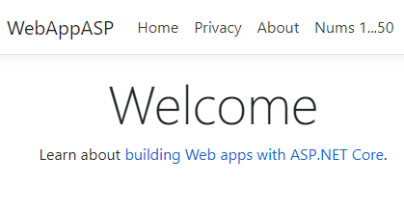
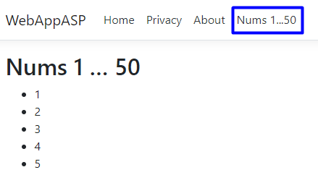
Checking Result
Press [Ctrl+F5]
You will see your app’s home page
Go to the newly created link and check result

Slide 15
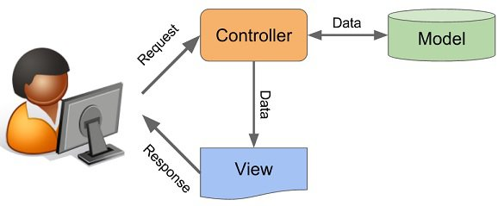
ASP.NET Controllers

Slide 16
ASP.NET Controllers
Controllers hold multiple actions on different routes
Route configuration is defined in RouteConfig.cs
Routes are automatically generated, based on RouteConfig
public class ArticleController : Controller
{
public IActionResult List(int id)
{
// Code comes here …
}
}
Action parameters
Generated route: /Article/List/{id}

Slide 17
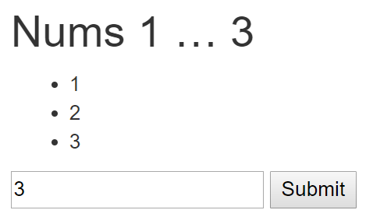
Example: Print the Numbers 1…N
HomeController.cs
\Views\Home\Numbers.cshtml
public class HomeController : Controller
{
public ActionResult Numbers(int count = 5)
{
ViewBag.Count = count;
return View();
}
}
@{ ViewBag.Title =
"Nums 1 … " + ViewBag.Count; }
<h2>@ViewBag.Title</h2>
<ul>
@for (int i = 1; i <= ViewBag.Count; i++) { <li>@i</li> }
</ul>
@using (Html.BeginForm())
{
@Html.TextBox("count");
<input type="submit" />
}

Slide 18
Controller Actions
Annotated with [Http{method}]
[HttpGet]
public IActionResult Index() {
return View();
}
[HttpPost]
public IActionResult Create()
{
…
}

Slide 19
Processing GET Requests
Create controller action, which processes a HTTP GET request:
Returns the view in Views/{controller}/{action}.cshtml
[HttpGet]
public ActionResult Index()
{
return View();
}

Slide 20
Processing POST Requests
Similar to [HttpGet], there is also an alias for method POST:
Similar attributes exist for all other types of request methods
[HttpPost]
public IActionResult Register()
{
…
}

Slide 21
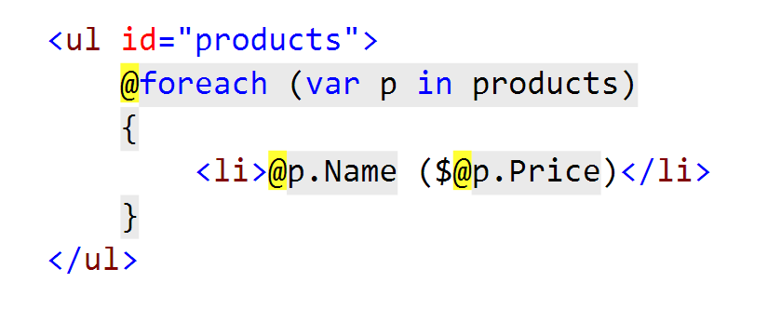
Razor View Engine
What is it? How do I use it?

Slide 22
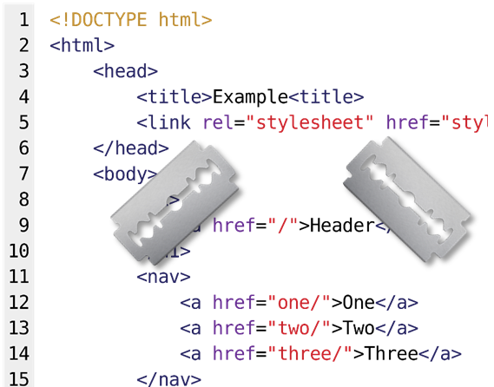
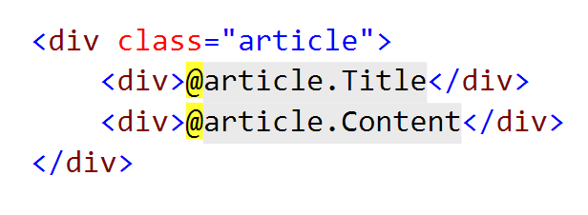
What is Razor?
Simple-syntax view engine
Code-focused templating approach
Easy transition between HTML and code
Examples: combining HTML and C#:

Slide 23
Razor View Engine: Example
HTML mixed with C# code (@ switches to C#):
<div class="row">
@foreach(var article in Model)
{
<article>
<h2>@article.Title</h2>
<p>@article.Content</p>
<small>--@article.Author.FullName</small>
</article>
}
</div>
C# foreach
C# code
HTML
Syntax
C# code

Slide 24
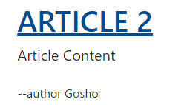
HTML Helpers: Example
We can use HTML helpers in Razor to generate HTML:
@Html.ActionLink(
article.Title,
"Details",
"Article",
new {
id = article.Id
},
new {
@class = "text-uppercase"
}
)
Link text
<a class="text-uppercase"
href="/Article/Details/2">
Article 2
</a>
HTML Result
Action
Controller
Controller Route Values
HTML Attributes

Slide 25
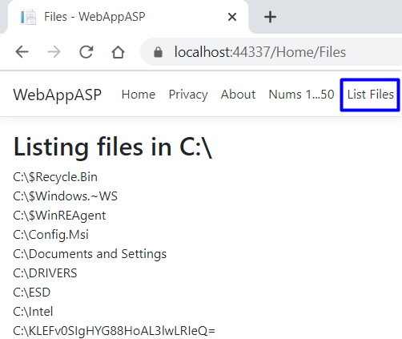
Example: List Files
Create an action Files to show the folders and files in C:\

Slide 26
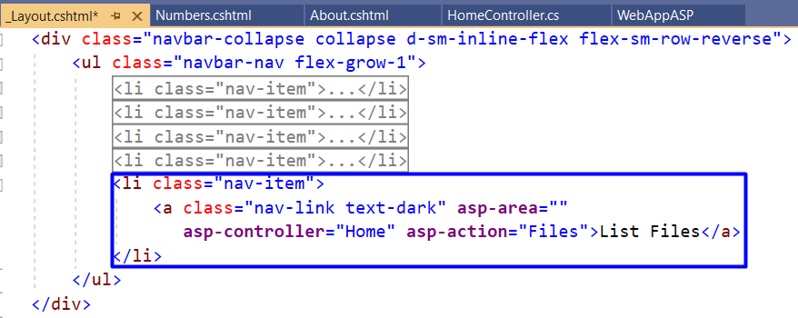
Solution: List Files
HomeController.cs
\Views\Home\Files.cshtml
public ActionResult Files()
{
var path = @"C:\";
var files = Directory
.GetDirectories(path)
.ToList();
files.AddRange(
Directory.GetFiles(path));
return View(files);
}
@{ ViewBag.Title = "Files"; }
<h2>Listing files in C:\</h2>
@model List<string>
@foreach (var file in Model)
{
<div> @file </div>
}

Slide 27
Summary
…
…
…
ASP.NET MVC is powerful Web dev platform
Views render HTML code
Controllers process HTTP GET / POST actions
@foreach (var item in @Model)
{ <li>@item</li> }
public ActionResult Index()
{ return this.View(GetAllItems()); }

Slide 28
Questions?
Notes:
28

Slide 29

License
This course (slides, examples, demos, exercises, homework, documents, videos and other assets) is copyrighted content
Unauthorized copy, reproduction or use is illegal
© SoftUni – https://softuni.org
© Software University – https://softuni.bg
Notes:
29

Slide 30
Trainings @ Software University (SoftUni)
Software University – High-Quality Education, Profession and Job for Software Developers
softuni.bg, softuni.org
Software University Foundation
softuni.foundation
Software University @ Facebook
facebook.com/SoftwareUniversity
Software University Forums
forum.softuni.bg
30
Notes:
30

